Slide 1
Bipolar Junction Transistors

Slide 2
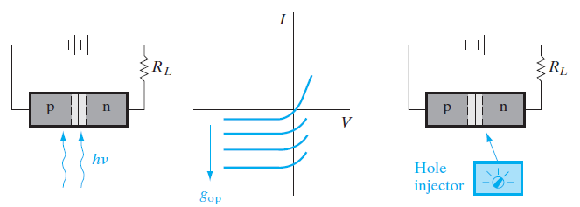
External control of the current in a reverse-biased p-n junction: (a) optical generation; (b) junction I–V characteristics as a function of EHP
generation; (c) minority carrier injection by a hypothetical device.

Slide 3
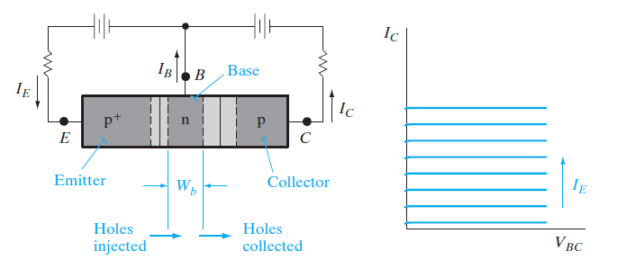
A convenient hole injection device is a forward-biased p+-n junction.
The current in such a junction is due primarily to holes injected from the p+ region into the n material.
If we make the n side of the forward-biased junction the same as the n side of the reverse-biased junction, the
p+-n-p structure of Fig.

Slide 4
With this configuration, injection of holes from the p+-n junction into the center n region supplies the minority carrier holes to participate in the reverse current through the n-p junction.
Of course, it is important that the injected holes do not recombine in the n region before they can diffuse to the depletion layer of the reverse-biased junction.
Thus we must make the n region narrow compared with a hole diffusion length.
The structure we have described is a p-n-p BJT.
The forward-biased junction that injects holes into the center n region is called the emitter junction, and the reverse-biased junction that collects the injected holes is called the collector junction.
The p+ region, which serves as the source of injected holes, is called the emitter, and the p region into which the holes are swept by the reverse-biased junction is called the collector.

Slide 5
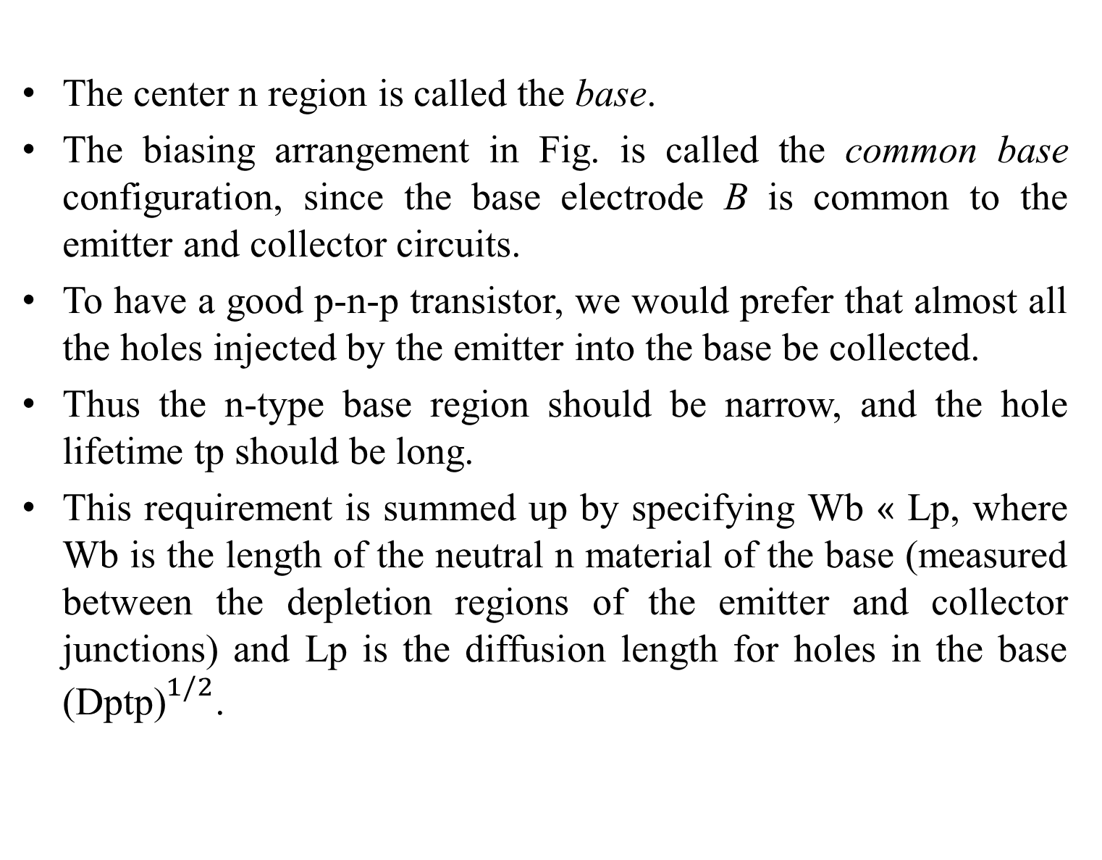
The center n region is called the base.
The biasing arrangement in Fig. is called the common base configuration, since the base electrode B is common to the emitter and collector circuits.
To have a good p-n-p transistor, we would prefer that almost all the holes injected by the emitter into the base be collected.
Thus the n-type base region should be narrow, and the hole lifetime tp should be long.
This requirement is summed up by specifying Wb « Lp, where Wb is the length of the neutral n material of the base (measured between the depletion regions of the emitter and collector junctions) and Lp is the diffusion length for holes in the base (${\text{Dptp}\text{)}}^{1/2}$.

Slide 6
With this requirement satisfied, an average hole injected at the emitter junction will diffuse to the depletion region of the collector junction without recombination in the base.
A second requirement is that the current IE crossing the emitter junction should be composed almost entirely of holes injected into the base, rather than electrons crossing from base to emitter.
This requirement is satisfied by doping the base region lightly compared with the emitter, so that the p+-n emitter junction results.

Slide 7
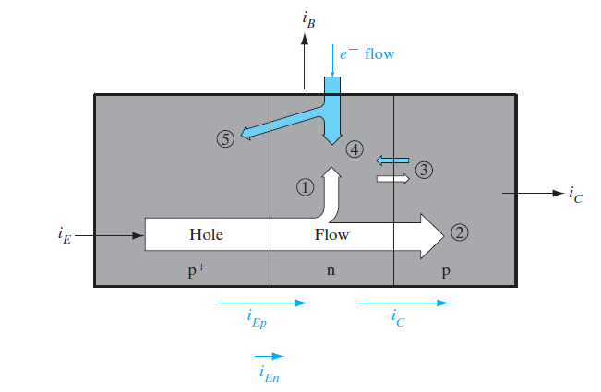

Slide 8
It is clear that current IE flows into the emitter of a properly biased p-n-p transistor and that Ic flows out at the collector, since the direction of hole flow is from the emitter to collector.
However, the base current IB requires a bit more thought.
In a good transistor the base current will be very small since IE is essentially hole current, and the collected hole current IC is almost equal to IE.
There must be some base current, however, due to requirements of electron flow into the n-type base region (Fig. 7–3).
We can account for IB physically by three dominant mechanisms:

Slide 9
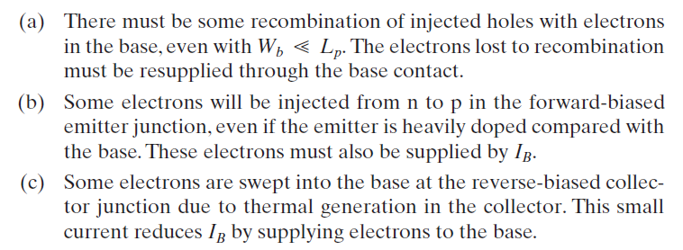

Slide 10
The dominant sources of the base current are (a) recombination in the base and (b) injection into the emitter region.
Both of these effects can be greatly reduced by device design.
In a well-designed transistor, IB will be a very small fraction (perhaps one-hundredth) of IE.
In an n-p-n transistor the three current directions are reversed, since electrons flow from the emitter to collector and holes must be supplied to the base.
The physical mechanisms for operation of the n-p-n can be understood simply by reversing the roles of electrons and holes in the p-n-p discussion.

Slide 11
Amplification with BJTS
Basically, the transistor is useful in amplifiers because the currents at the emitter and collector are controllable by the relatively small base current.
The essential mechanisms are easy to understand if various secondary effects are neglected.
We shall use total current (d-c plus a-c) in this discussion, with the understanding that the simple analysis applies only to d-c and to small-signal a-c at low frequencies.
We can relate the terminal currents of the transistor iE, iB, and iC by several important factors.
In this introduction we shall neglect the saturation current at the collector (Fig. 7–3, component 3) and such effects as recombination in the transition regions.

Slide 12
Under these assumptions, the collector current is made up entirely of those holes injected at the emitter, which are not lost to recombination in the base.
Thus iC is proportional to the hole component of the emitter current iEp:

Slide 13

The proportionality factor B is simply the fraction of injected holes which make it across the base to the collector; B is called the base transport factor.
The total emitter current iE is made up of the hole component iEp and the electron component iEn , due to electrons injected from the base to emitter (component 5 in Fig. 7–3).
The emitter injection efficiency 𝞬 is
For an efficient transistor we would like B and 𝞬 to be very near unity; that is, the emitter current should be due mostly to holes
(𝞬~ 1), and most of the injected holes should eventually participate
in the collector current (B ~1).
The relation between the collector and emitter currents is

Slide 14


Slide 15
The product B𝞬 is defined as the factor 𝞪, called the current transfer ratio, which represents the emitter-to-collector current amplification.
There is no real amplification between these currents, since 𝞪 is smaller than unity.
On the other hand, the relation between iC and iB is more promising for amplification.

Slide 16

In accounting for the base current, we must include the rates at which electrons are lost from the base by injection across the emitter junction (iEn) and the rate of electron recombination with holes in the base.
In each case, the lost electrons must be resupplied through the base current iB.
If the fraction of injected holes making it across the base without recombination is B, it follows that (1-B) is the fraction recombining in the base.
Thus the base current is
neglecting the collector saturation current.
The relation between the collector and base currents is found

Slide 17
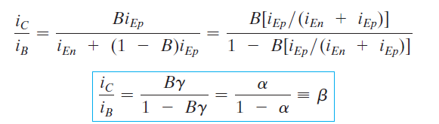
The factor 𝞫 relating the collector current to the base current is the base-to-collector current amplification factor.
Since 𝞪 is near unity, it is clear that 𝞫 can be large for a good transistor, and the collector current is large compared with the base current.

Slide 18
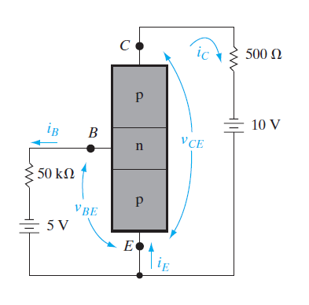
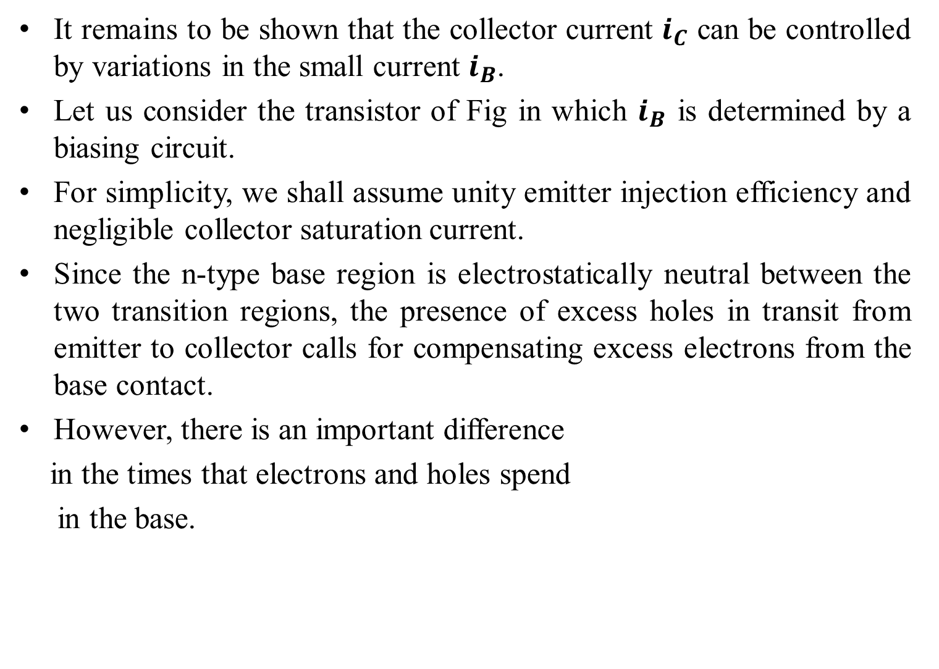
It remains to be shown that the collector current $i_{C}$ can be controlled by variations in the small current $i_{B}$.
Let us consider the transistor of Fig in which $i_{B}$ is determined by a biasing circuit.
For simplicity, we shall assume unity emitter injection efficiency and negligible collector saturation current.
Since the n-type base region is electrostatically neutral between the two transition regions, the presence of excess holes in transit from emitter to collector calls for compensating excess electrons from the base contact.
However, there is an important difference
in the times that electrons and holes spend
in the base.

Slide 19
The average excess hole spends a time 𝞽t, defined as the transit time from the emitter to collector.
Since the base width Wb is made small compared with Lp, this transit time is much less than the average hole lifetime 𝞽p in the base.
On the other hand, an average excess electron supplied from the base contact spends 𝞽p seconds in the base supplying space charge neutrality during the lifetime of an average excess hole.
While the average electron waits 𝞽p seconds for recombination, many individual holes can enter and leave the base region, each with an average transit time 𝞽t .
In particular, for each electron entering from the base contact,
𝞽p>𝞽t holes can pass from the emitter to collector while
maintaining space charge neutrality.
Thus the ratio of collector current to base current is simply

Slide 20
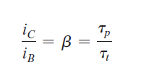
for 𝞬= 1 and negligible collector saturation current.
The base current is controlled independently in Fig.
This is called a common-emitter circuit, since the emitter electrode is common to the base and collector circuits.

Slide 21
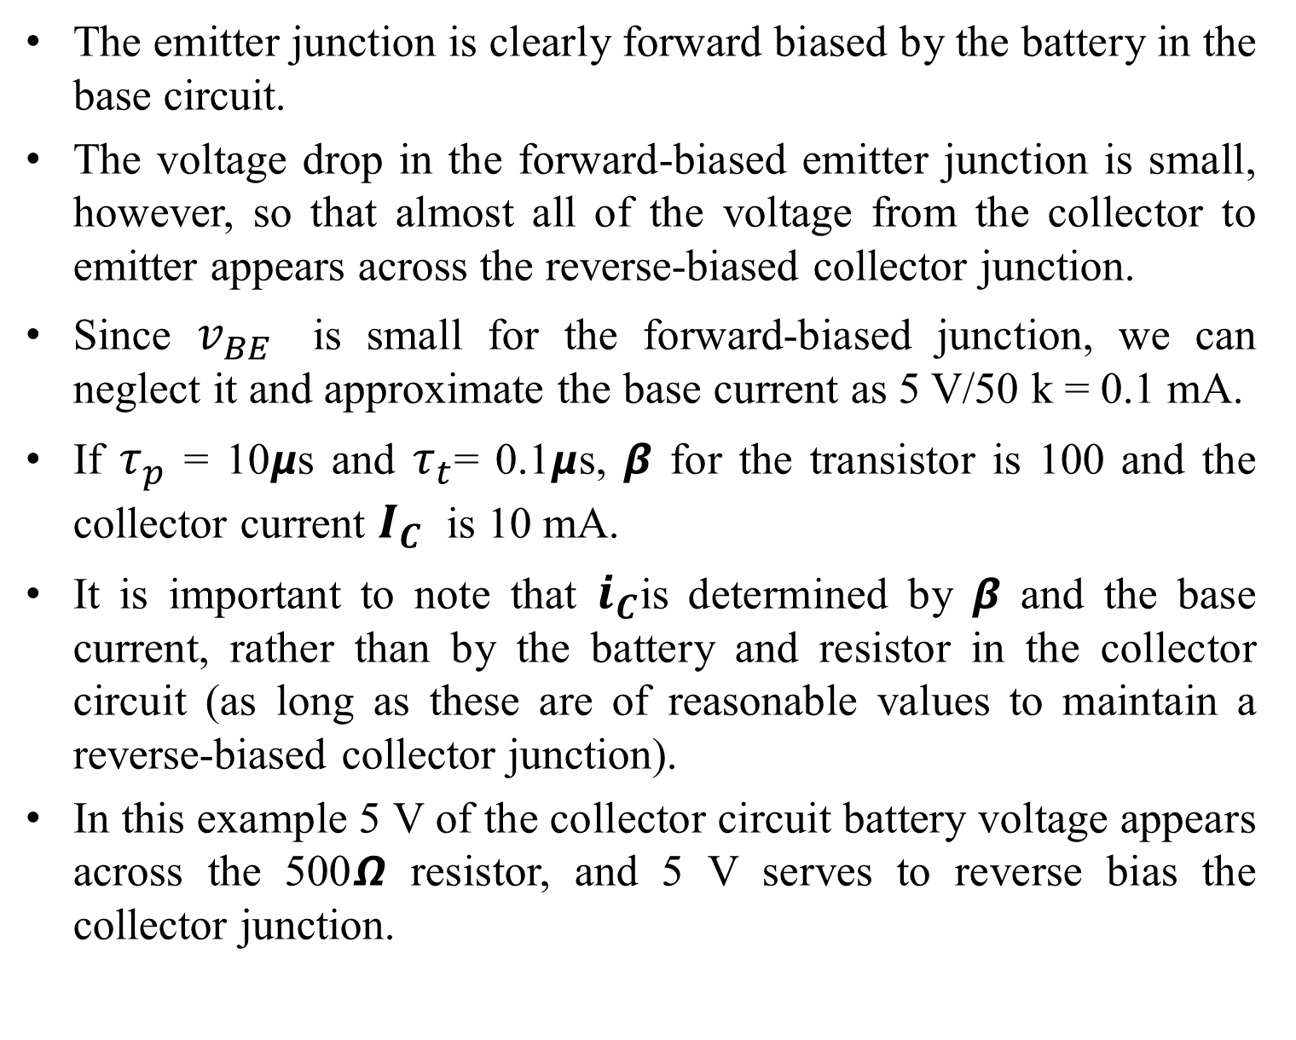
The emitter junction is clearly forward biased by the battery in the base circuit.
The voltage drop in the forward-biased emitter junction is small, however, so that almost all of the voltage from the collector to emitter appears across the reverse-biased collector junction.
Since $v_{BE}$ is small for the forward-biased junction, we can neglect it and approximate the base current as 5 V/50 k = 0.1 mA.
If $τ_{p}$ = 10𝞵s and $τ_{t}$= 0.1𝞵s, 𝞫 for the transistor is 100 and the collector current $I_{C}$ is 10 mA.
It is important to note that $i_{C}$is determined by 𝞫 and the base current, rather than by the battery and resistor in the collector circuit (as long as these are of reasonable values to maintain a reverse-biased collector junction).
In this example 5 V of the collector circuit battery voltage appears across the 500𝞨 resistor, and 5 V serves to reverse bias the collector junction.

Slide 22

If a small a-c current $i_{B}$ is superimposed on the steady state base current of Fig. , a corresponding a-c current $i_{C}$appears in the collector circuit.
The time-varying portion of the collector current will be $i_{B}$multiplied by the factor 𝞫, and current gain results.

Slide 23
The first transistor invented by Bardeen and Brattain in 1947 was the point contact transistor. In this device two sharp metal wires, or “cat’s whiskers,” formed an “emitter” of carriers and a “collector” of carriers.
These wires were simply pressed onto a slab of Ge which provided a “base” or mechanical support, through which the injected carriers flowed.
This basic invention rapidly led to the BJT, in which charge injection and collection was achieved using two p-n junctions in proximity to each other.
A simplified version of double polysilicon, self-aligned n-p-n Si BJT.
This is the most commonly used, state-of-the art technique for making BJTs for use in an IC.
Use of n-p-n transistors is more popular than p-n-p devices because of the higher mobility of electrons compared with holes.

Slide 24
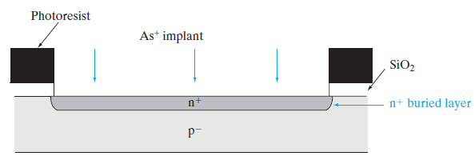
A p-type Si substrate is oxidized, windows are defined using photolithography and etched in the oxide.
Using the photoresist and oxide as an implant mask, a donor with very small diffusivity in Si, such as As or Sb, is implanted into the open window to form a highly conductive n+ layer.

Slide 25
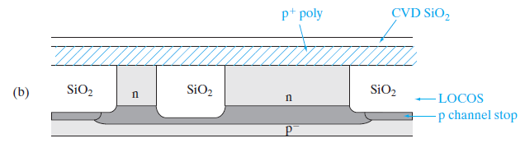
Subsequently, the photoresist and the oxide are removed, and a lightly doped n-type epitaxial layer is grown.
During this high temperature growth, the implanted n+ layer diffuses only slightly toward the surface and becomes a conductive buried collector (also called a sub-collector).
The n+ sub-collector layer guarantees a low collector series resistance when it is connected subsequently to the collector ohmic contact, sometimes through the use of an optional, masked deep n+ “sinker” implant or diffusion only in the collector contact region.

Slide 26
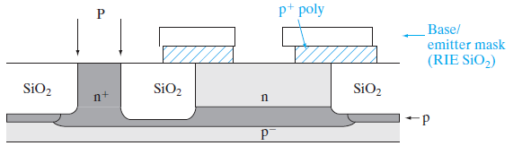

Slide 27
The lightly doped n-type collector region above the n+ sub-collector in the part of the BJT where the base and emitter are formed ensures a high base-collector reverse breakdown voltage.
For integrated circuits involving not just discrete BJTs, but many interconnected transistors, there are issues involving electrical isolation of adjacent BJTs in order to ensure that there is no electrical cross-talk between them.
An isolation can be achieved by LOCOS to form field or isolation oxides after a B channel stops implant.
Another isolation scheme that is particularly well suited for high-density bipolar circuits involves the formation of shallow trenches by reactive ion etching (RIE), backfilled with oxide and polysilicon.
In this process a nitride layer is patterned and used as an etch mask for an anisotropic etch of the silicon to form the trench.

Slide 28
Using RIE, a narrow trench about 1 𝞵m deep can be formed with very straight sidewalls.
Oxidation inside the trench forms an insulating layer, and the trench is then filled with oxide by low-pressure chemical vapor deposition (LPCVD).
A polysilicon layer is deposited by LPCVD, and doped heavily p+ with B during deposition.
An oxide layer is deposited next by LPCVD.
Using photolithography with the base/emitter mask, a window is etched in the polysilicon/oxide stack by RIE

Slide 29
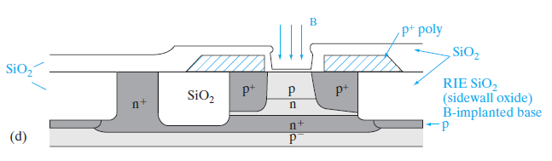
A heavily doped “extrinsic” p+ base is formed by diffusion of B from the doped polysilicon layer into the substrate in order to provide a low-resistance, high-speed base ohmic contact.
An oxide layer is then deposited by LPCVD, which has the effect of closing up the base window that was etched previously, and B is implanted into this window.
This base implant forms a more lightly p doped “intrinsic” base through which most of the current flows from the emitter to the collector.

Slide 30
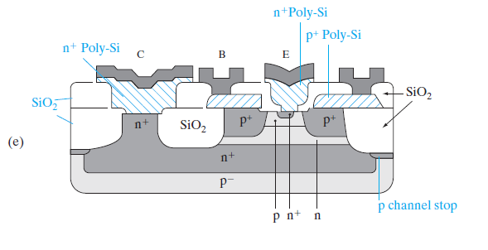
The more heavily doped extrinsic base forms a collar around the intrinsic base, and serves to reduce the base series resistance.
Finally, another LPCVD oxide layer is deposited to close up the base window further, and the oxide is etched all the way to the Si substrate by RIE, leaving oxide spacers on the sidewalls.
Heavily n+ doped (typically with As) polysilicon is then deposited on the substrate, patterned and etched, forming polysilicon emitter (polyemitter) and collector contacts, as shown in Fig. 7–5e.

Slide 31
The use of two LPCVD polysilicon layers explains why this process is referred to as the double-polysilicon process.
Arsenic from the polysilicon is diffused into the substrate to form the n+ emitter region nested within the base in a self-aligned manner, as well as the n+ collector contact.
Self-alignment refers to the fact that a separate lithography step is not required to form the n+ emitter region.
The oxide sidewall spacers is used to ensure that the n+ emitter region lies within the intrinsic p-type base.
This is critical because otherwise the emitter gets shorted to the collector; we also want a gap between the n+ emitter and the p+ extrinsic base, because otherwise the emitter–base junction capacitance becomes too high.
In the vertical direction, the difference between the emitter–base junction and the base–collector junction determines the base width.
This is made very narrow in high gain, high speed BJTs.

Slide 32
Finally, an oxide layer is deposited by CVD, windows are etched in it corresponding to the emitter (E), base (B), and collector (C) contacts, and a suitable contact metal such as Al is sputter deposited to form the ohmic contacts.
The Al is patterned photolithographically using the interconnect mask, and etched using RIE.
The many ICs that are made simultaneously on the wafer are then separated into individual dies by sawing, mounted on suitable packages, and the various contacts are wire bonded to the external leads of the package.

